Slide 1
FreeProbe: Towards Low-Overhead Runtime
Observability for High-Performance User-Space Systems
Kai Huang · Presenter
k.huang@seu.edu.cn
APNet 2026 · Singapore · August 7, 2026
Kai Huang · Bin Yang · Xinshu Wang · Beilun Wang · Dian Shen
School of Computer Science and Engineering · Southeast University
Notes:
Good afternoon. I’m Kai Huang from Southeast University. Today I’ll present FreeProbe, our approach to low-overhead runtime observability for high-performance user-space systems. The key idea is simple: decide whether to sample before paying the interception cost.

Slide 2



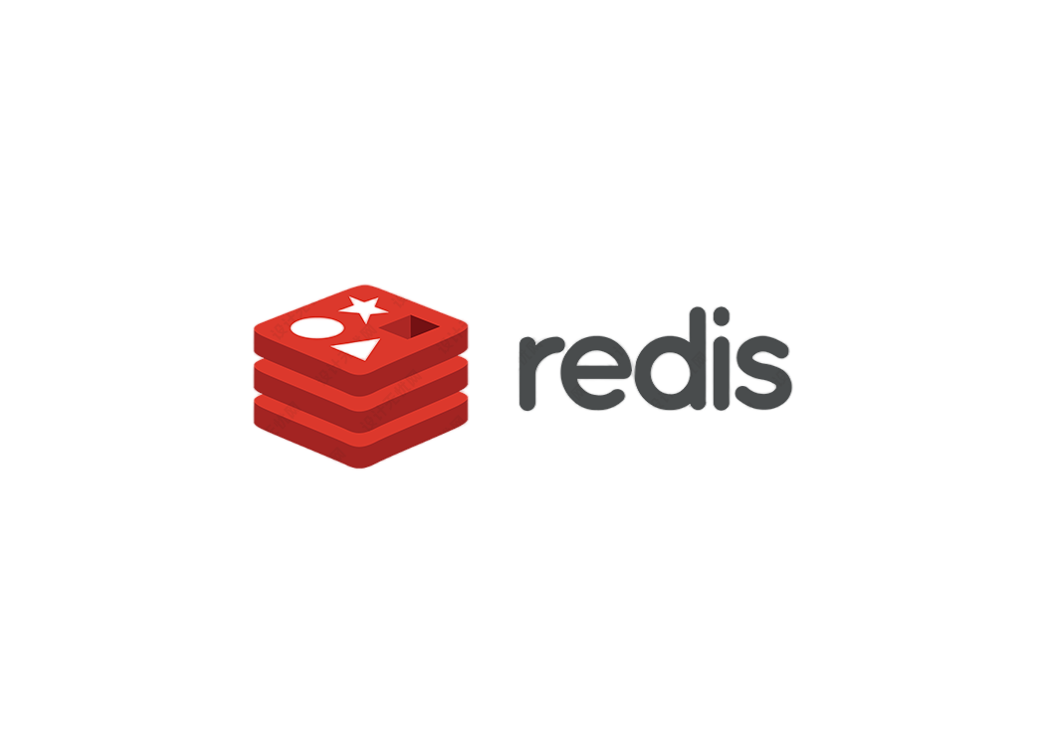


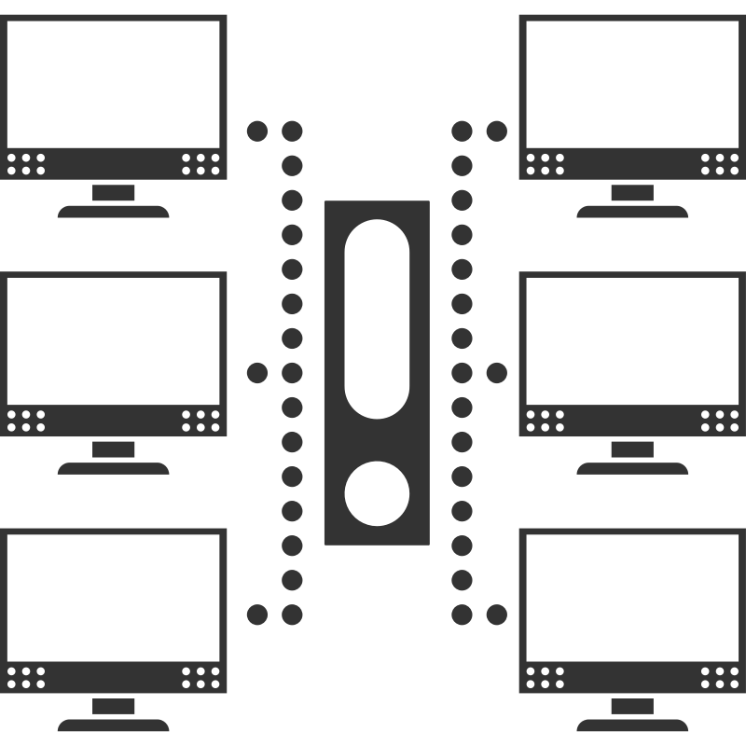



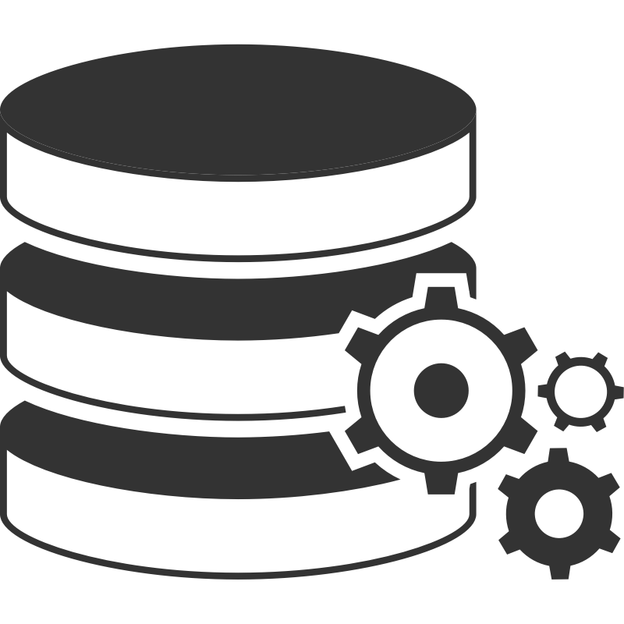
Why runtime observability matters
High-performance
user-space systems
High-throughput, low-latency networking: DPDK and VPP
User-space storage and key-value stores: SPDK and Redis
Distributed deep-learning frameworks
User space
Runtime metrics
Performance counters: cache misses, cycles, ...
Scheduler statistics: throughput, timeout rate, ...
Observe
System Optimization
Notes:
High-performance systems increasingly move critical work into user space. Examples include DPDK and VPP for networking, SPDK for storage, Redis, and distributed learning systems. These systems are optimized continuously, and that process depends on runtime metrics. Without visibility into the hot path, we cannot identify the right optimization.

Slide 3

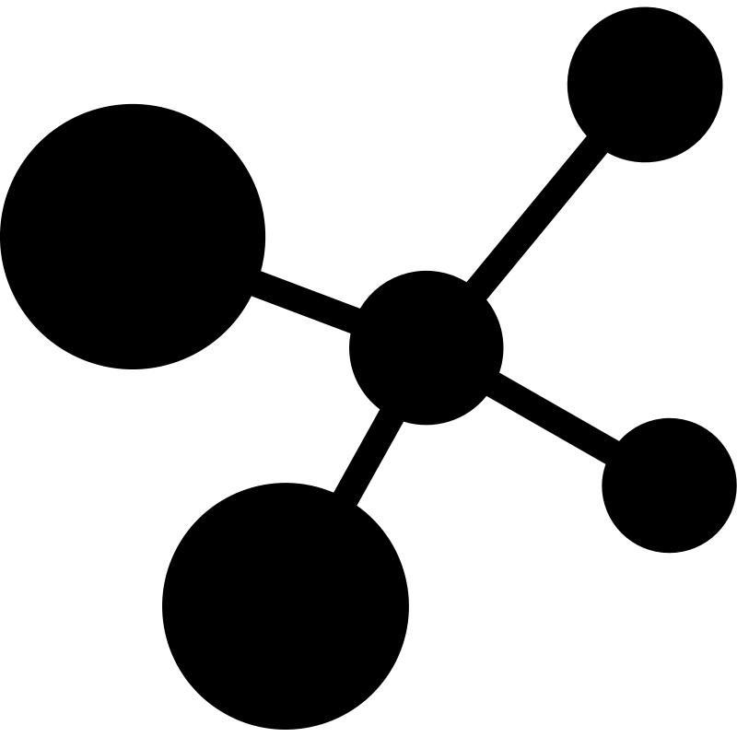

Internal metrics reveal hidden bottlenecks
Infrastructure metrics
Internal metrics
Inside the system
Low-level metrics:
Cycles per instruction (CPI)
Cache-miss rate
Kernel statistics:
Page-fault count
Scheduler parameters
Per-function execution time
Invocation-frequency distribution
Internal queueing delay
Per-operator execution latency
NF-chain throughput
Standard profiling tools
Coarse-grained view
Low collection cost
Native support or instrumentation
Fine-grained signals
Higher collection cost
Notes:
We use two broad classes of metrics. Infrastructure metrics, such as performance counters and scheduler statistics, are easy to collect but give only a coarse-grained view. Internal metrics, such as per-function latency, invocation frequency, and queueing delay, reveal where time is actually spent. They are much more actionable, but also much harder to expose.

Slide 4



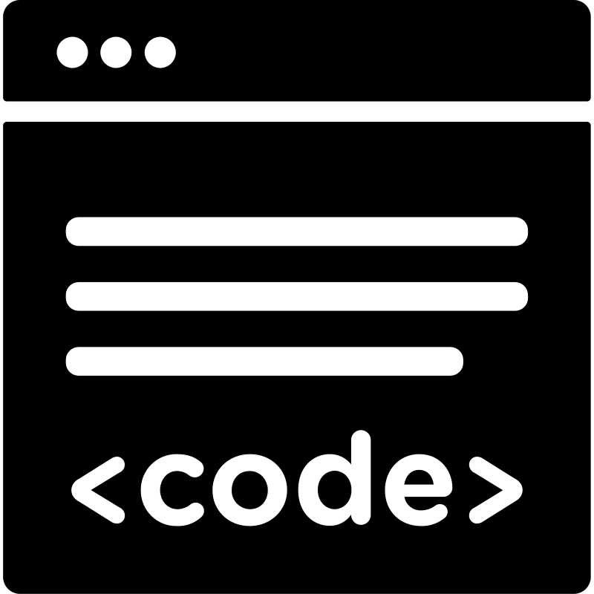





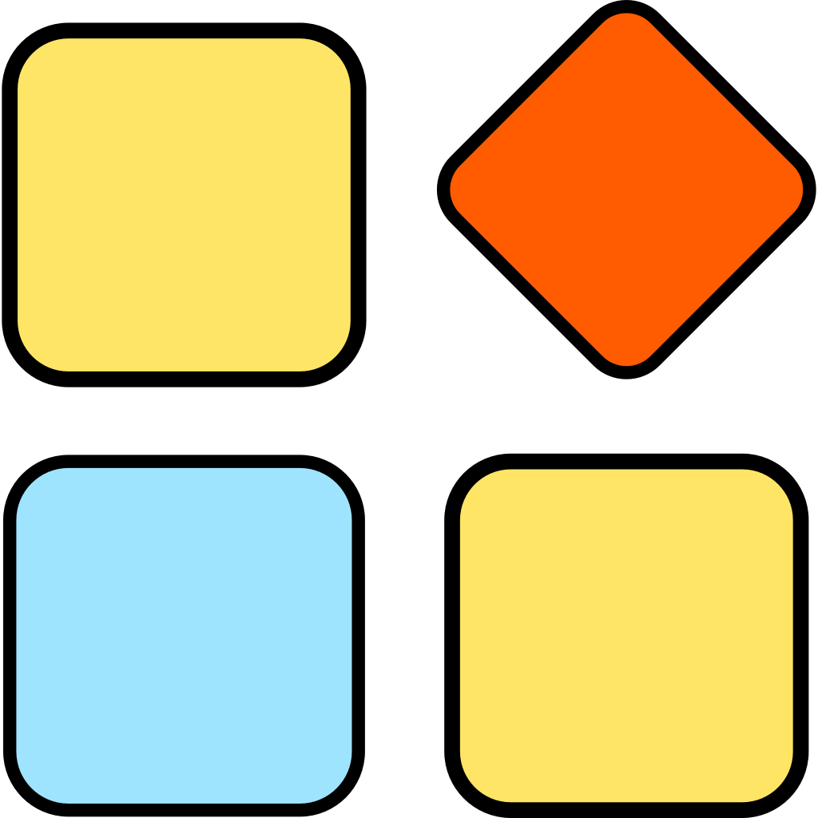

Internal metrics are costly to expose
Intrusive instrumentation
6,000+ lines
Python/BESS
NF-Graph
Batch Optimization
Source-code modification
  Insert monitoring logic to export internal metrics
  Low runtime overhead, but high engineering cost
Static instrumentation
  Inject probes at compile or link time
  Fixed in the binary; cannot change at runtime
1,000+ lines
C/C++
VPP RL tuning
Runtime instrumentation
Build
Runtime instrumentation combines dynamic tracing with a restricted execution model such as eBPF.
  Uprobe: kernel-assisted dynamic tracing + eBPF
  Bpftime: Frida-based binary instrumentation + a user-space eBPF runtime
Notes:
There are two common ways to obtain internal metrics. Static instrumentation runs inline and is fast, but it requires source changes, rebuilding, and substantial engineering effort. Prior work needed more than six thousand lines for NF-Graph, and our own VPP tuning work required about one thousand lines. Runtime instrumentation is easier to deploy, using Uprobe or Bpftime, but the interception path becomes expensive for microsecond-scale functions.

Slide 5




Sampling misses still pay interception cost
Non-intrusive instrumentation offers excellent flexibility and deployability,
but incurs significant runtime overhead
Numerical statistics
Enough signal
Lower collection cost
Sampling
Event traces
Uprobe
Trap into the kernel
Two user–kernel transitions
Instrumentation logic
I1
I2
Trap
Sampling logic
Probe
Bpftime
Jump to user-space eBPF
Save context + transfer control
I4
Jump
Overhead has already been paid.
I5
Notes:
Sampling appears to solve the overhead problem, but existing tools sample too late. With Uprobe, we first trap into the kernel and cross the user–kernel boundary. With Bpftime, we still jump to the user-space runtime and preserve the execution context. Only then does the eBPF handler decide whether to keep the event. So a sampling miss avoids collection work, but not interception work.

Slide 6
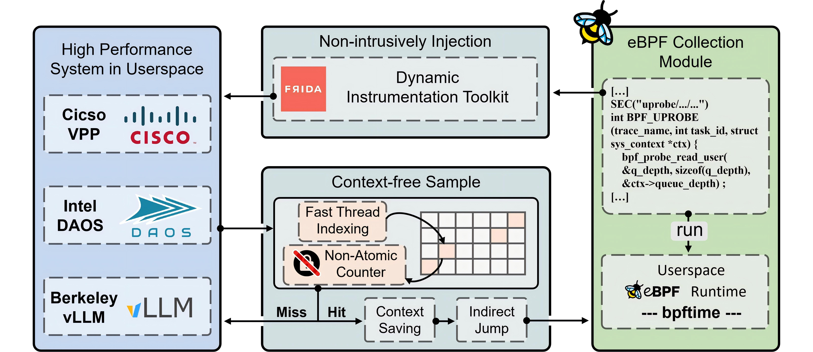
Freeprobe
Can instrumentation in user-space be both non-intrusive and low-overhead?
Early sampling
A miss bypasses context saving and eBPF execution.
Per-thread counters
Efficient counter-isolation mechanism under multithreaded concurrency.
Notes:
FreeProbe moves that decision to the beginning of the trampoline. It builds on Bpftime and Frida, while keeping eBPF as the programmable collection module. On a sampling miss, execution returns directly to the application. We avoid context saving, the indirect jump, and eBPF execution. On a hit, the normal instrumentation path is preserved. The second design component isolates sampling counters across threads.

Slide 7
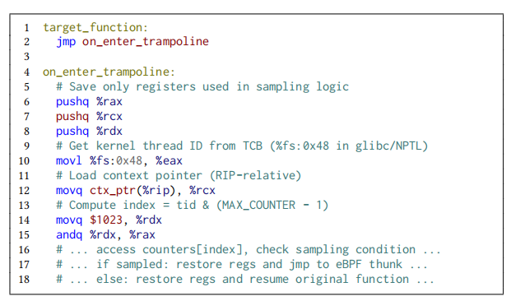

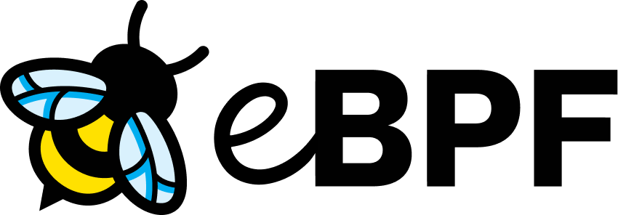
Design
Context-free sampling
Per-thread counters
Core idea: Decide before context preservation and control transfer.
Implementation: Put the sampling decision in Frida’s trampoline.
Challenge: Shared counters race; pthread_getspecific() adds a TLS call.
Implementation: Read the thread ID through fs and index the counter directly.
A miss returns before context saving; a hit follows the original Bpftime path.
Context-free Sample
Fast Thread Indexing
Non-Atomic
Counter
Userspace
Runtime
--- bpftime ---
Miss
Hit
Context Saving
Indirect Jump
Early sampling
Notes:
There are two implementation details. First, context-free sampling is inserted before context preservation and control transfer, so non-sampled events bypass the expensive path entirely. Second, a shared counter would introduce races and sampling bias. A conventional TLS lookup through pthread_getspecific also adds a function call to the hot path. Instead, FreeProbe stores counters in the probe context, reads the thread identifier through the fs register on x86 Linux, and indexes the per-thread counter directly.

Slide 8
Evaluation
Instrumentation Performance Comparison
Target: VPP ipv6-rewrite (1.48 µs baseline)
Baselines: Uprobe and Bpftime sample inside the eBPF program.
Why FreeProbe: non-sampled events exit before context saving and control transfer.
Notes:
We evaluate FreeProbe on VPP. Here the target is ipv6-rewrite, whose baseline execution time is about 1.48 microseconds. The bars show interception time, and the lines show throughput drop as the sampling rate increases. Uprobe and Bpftime both pay a large fixed cost because sampling occurs inside the eBPF program. At a one-percent sampling rate, FreeProbe adds only 1.83 percent overhead—98.60 percent below Uprobe and 94.68 percent below Bpftime.

Slide 9
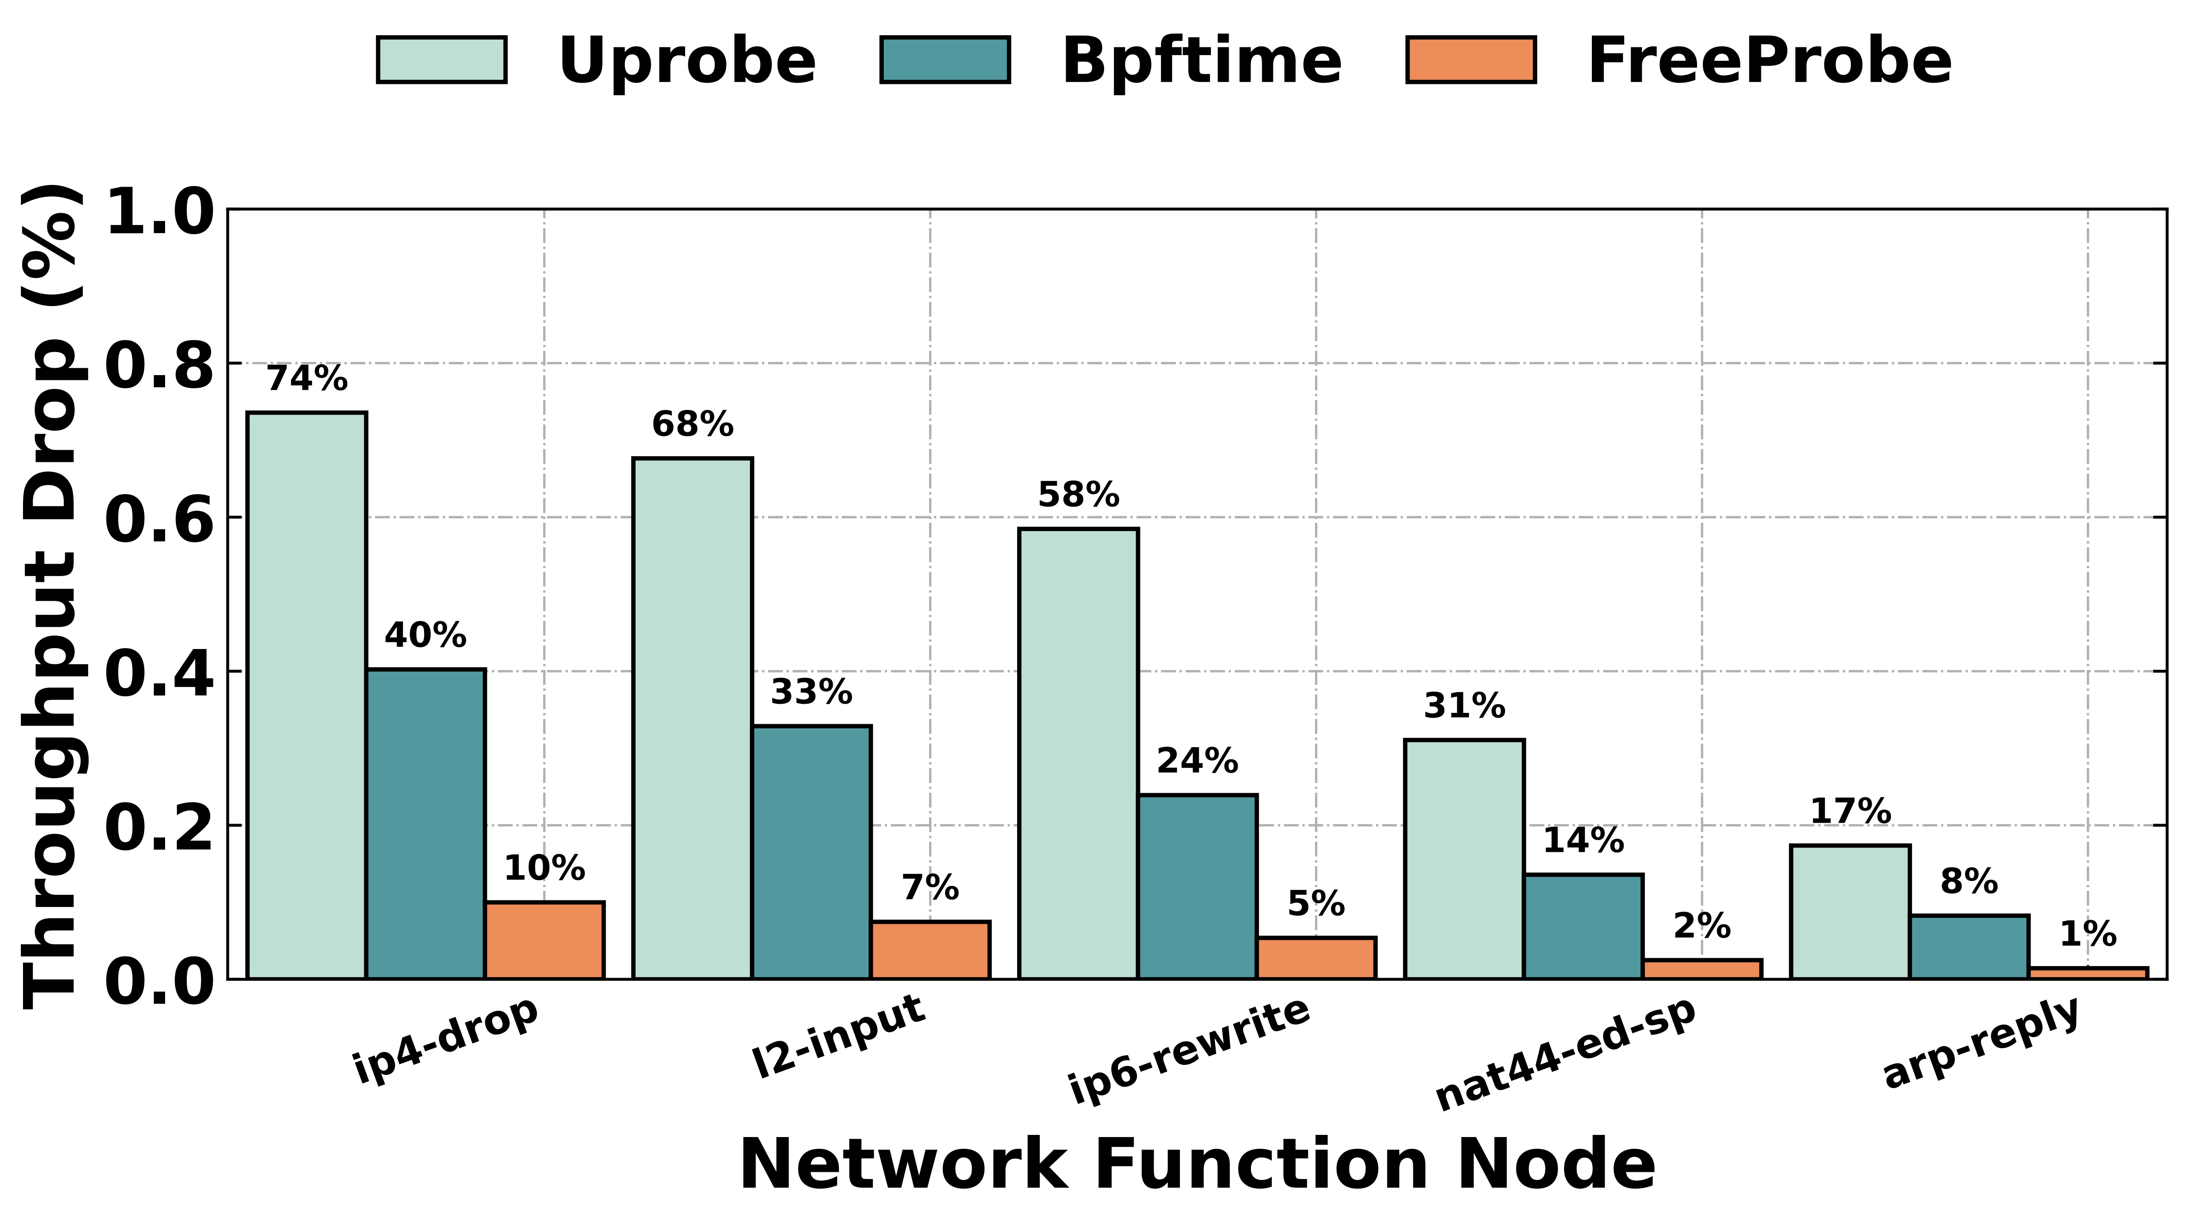
Evaluation
Observation-Target Sensitivity
Sampling rate: fixed at 5%.
Targets: ip4-drop, l2-input, ip6-rewrite, nat44-ed-sp, and arp-reply.
Result: FreeProbe remains stable as functions get shorter; Uprobe and Bpftime collapse when interception dominates execution time.
Notes:
Next, we fix the sampling rate at five percent and vary the target-function duration across five VPP nodes. As functions become shorter, the fixed interception cost dominates Uprobe and Bpftime. For the shortest node, ip4-drop, their throughput loss reaches 74 and 40 percent. FreeProbe limits the loss to about 10 percent because only sampled events pay for context preservation. This shows that the design remains practical at fine granularity.

Slide 10
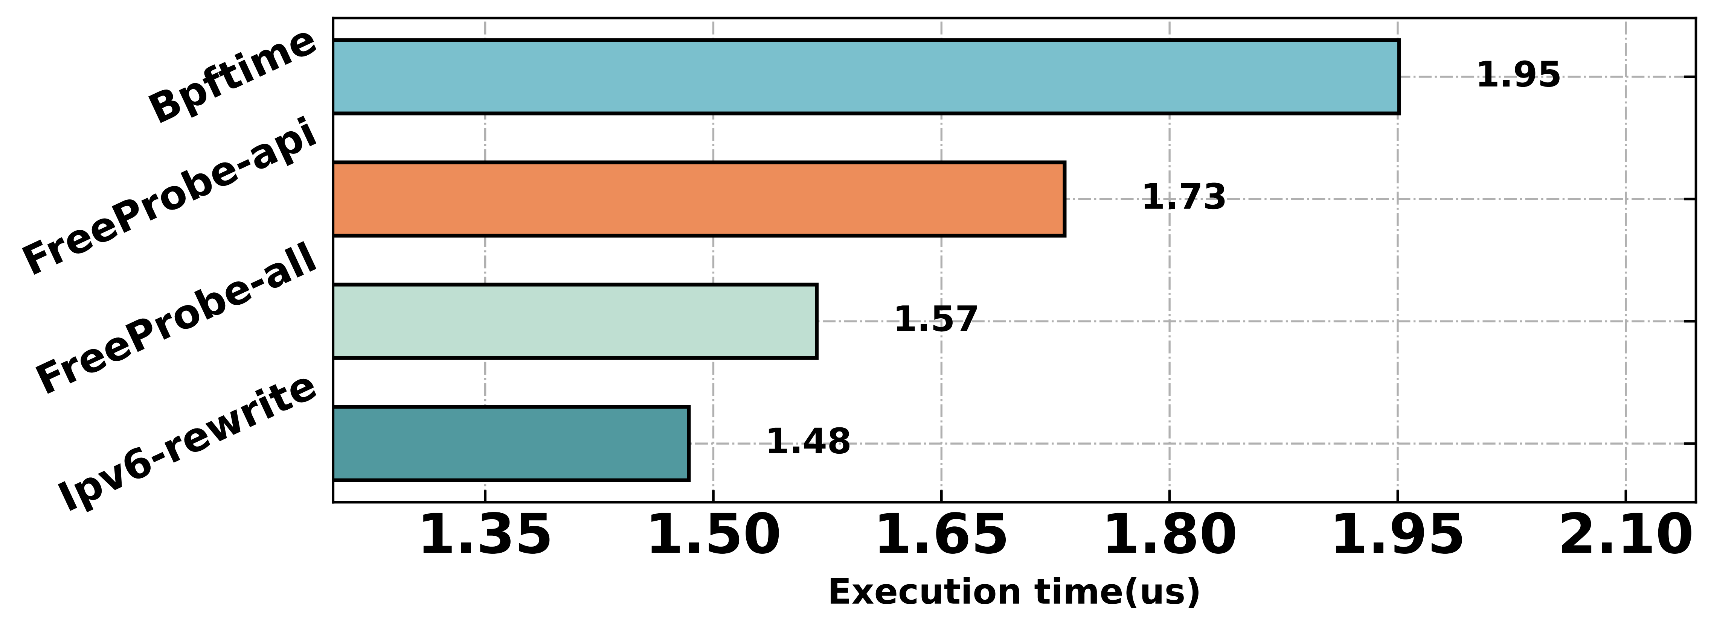
Evaluation
Ablation Experiment
Goal: validate counter isolation under concurrent execution.
Comparison: fs-register thread indexing vs. pthread_getspecific() on VPP ipv6-rewrite.
Result: fast thread indexing improves performance by 31.03%.
Notes:
Finally, we isolate the effect of fast thread indexing. We compare the fs-register design with a baseline that uses pthread_getspecific on VPP ipv6-rewrite. Removing the TLS API call and indexing the per-thread counter directly improves performance by 31.03 percent.

Slide 11
Thanks！
Notes:
Thank you for your attention! I'm happy to take any questions.
Q1. Why can't Bpftime simply move the sampling decision earlier?
A1:Because in Bpftime, sampling happens after context saving and runtime transfer. Even a sampling miss still pays the interception cost. FreeProbe makes the decision before these steps.
Q2. Does early sampling affect correctness?
A2:No. It only changes when the sampling decision is made. Sampled events follow the original path, while non-sampled events are skipped as intended.
Q3. Why not use pthread_getspecific?
A3:It adds a TLS function call on the hot path. FreeProbe reads the thread ID directly from the fs register and indexes the per-thread counter with lower overhead.
Q4. Can FreeProbe be applied to other frameworks?
A4:Yes. The core ideas—early sampling and per-thread counter isolation—are general and can be integrated into other DBI frameworks with similar trampolines.
Q5. What is the main limitation of FreeProbe?
A5:FreeProbe is built upon sampling-based observability. While this de_x0002_sign significantly reduces instrumentation overhead, it also inherits the inherent limitations of sampling techniques.
I'd be happy to discuss more details after the session.

